Slide 1

presentation of system modelling

Slide 2
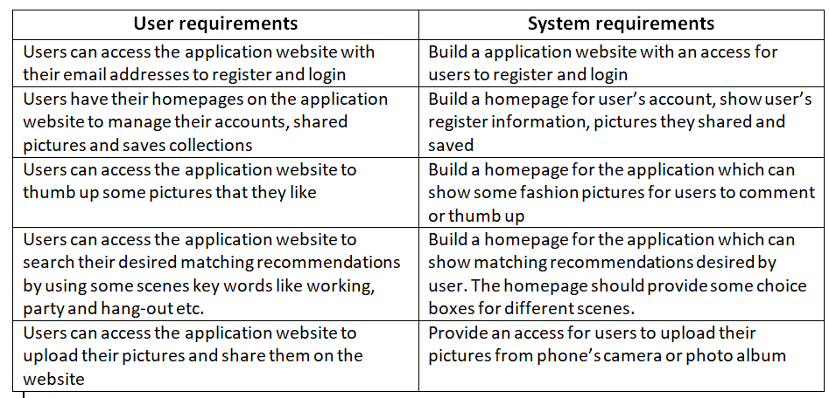
requirements

Slide 3
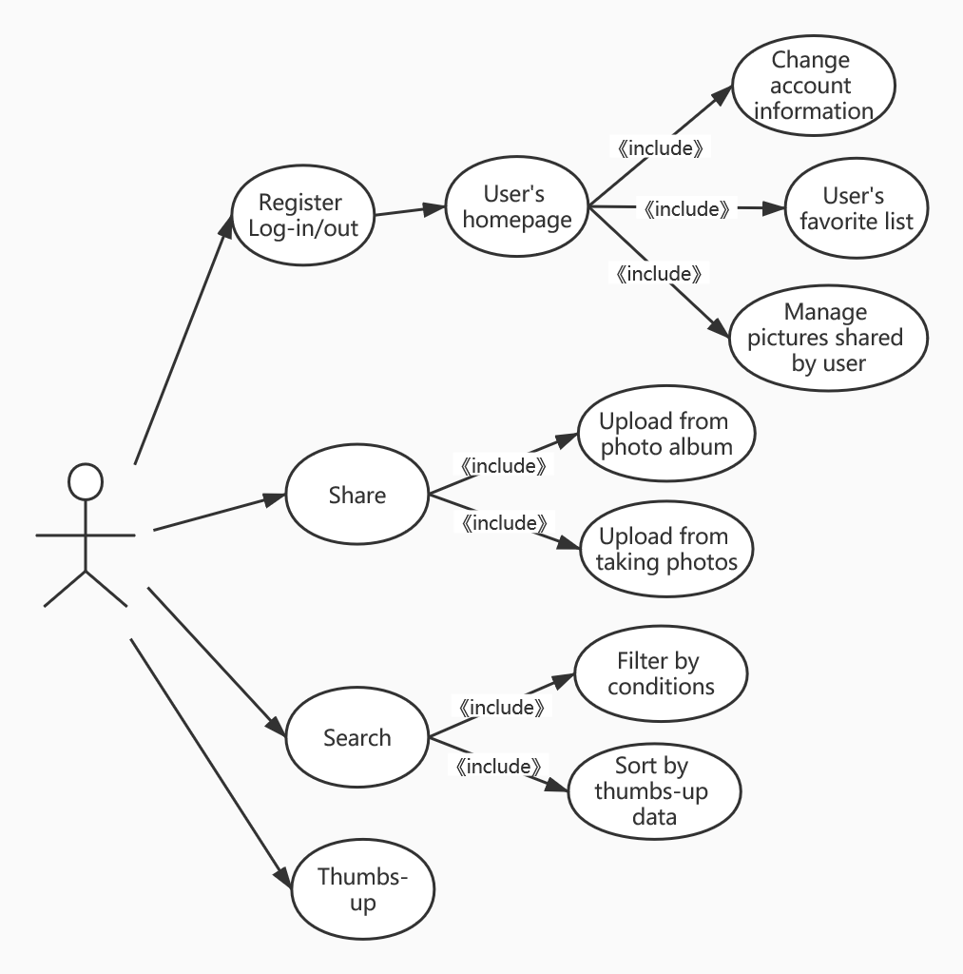
use case diagram for user requirements

Slide 4
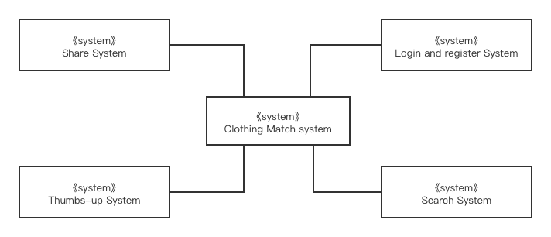
THE CONTEXT OF OVERALL SYSTEM

Slide 5
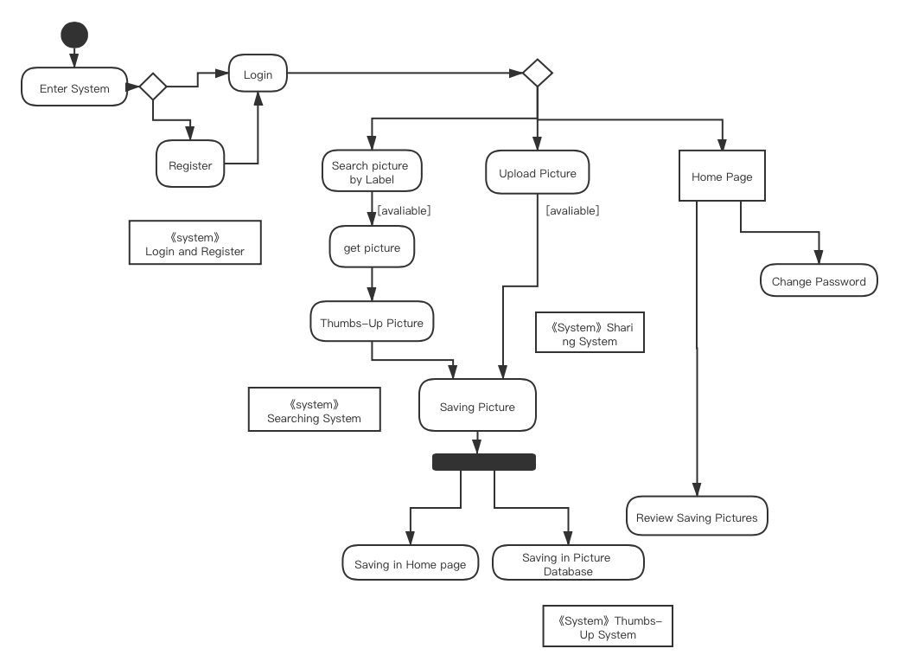
ACTIVITY DIAGRAM FOR EVERY SUBSYSTEM REQUIREMENTS

Slide 6
